Slide 1
Database Systems
AICT005-4-1-Database Systems (version1)
Week 4: Relational Database
(Part 1)

Slide 2
Topic & Structure of The Lesson
Relational table
Relational model components
Data integrity rules
Data dictionary

Slide 3
Learning Outcomes
At the end of this topic, You should be able to
Explain the relational model’s basic components
Explain how relations are organized in tables
Explain how data redundancy is handled in the relational database model

Slide 4
Key Terms You Must Be Able To Use
If you have mastered this topic, you should be able to use the following terms correctly in your assignments and exams:
Primary key
Foreign key
Candidate key
Attribute
domain

Slide 5
A Logical View of Data
Relational model
Enables programmer to view data logically rather than physically
Table
Has advantages of structural and data independence
Resembles a file from conceptual point of view
Easier to understand than its hierarchical and network database predecessors

Slide 6
Tables and Their Characteristics
Table: two-dimensional structure composed of rows and columns
Contains group of related entities = an entity set
Terms entity set and table are often used interchangeably

Slide 7
Tables and Their Characteristics (continued)
Table also called a relation because the relational model’s creator, Codd, used the term relation as a synonym for table
Think of a table as a persistent relation:
A relation whose contents can be permanently saved for future use

Slide 8
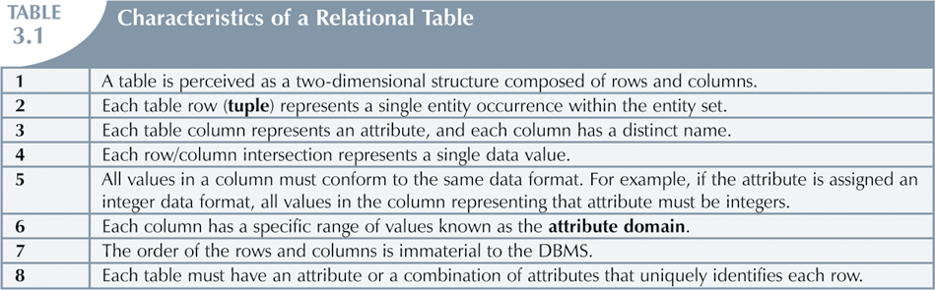
Tables and Their Characteristics (continued)

Slide 9
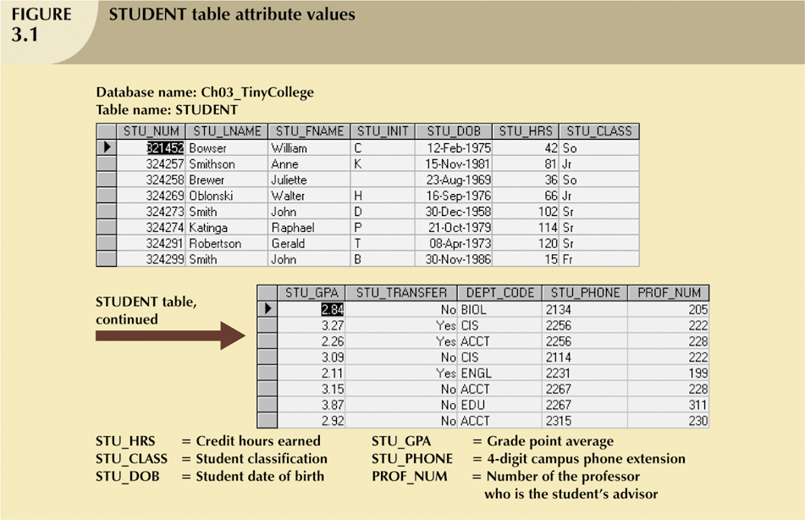
Tables and Their Characteristics (continued)

Slide 10
Keys
Consists of one or more attributes that determine other attributes
Primary key (PK) is an attribute (or a combination of attributes) that uniquely identifies any given entity (row)
Key’s role is based on determination
If you know the value of attribute A, you can look up (determine) the value of attribute B

Slide 11
Keys (continued)
Foreign key (FK)
An attribute whose values match primary key values in the related table
Referential integrity
FK contains a value that refers to an existing valid tuple (row) in another relation

Slide 12
Candidate Key
A Candidate Key can be any column or a combination of columns that can qualify as unique key in database. There can be multiple Candidate Keys in one table. Each Candidate Key can qualify as Primary Key.

Slide 13
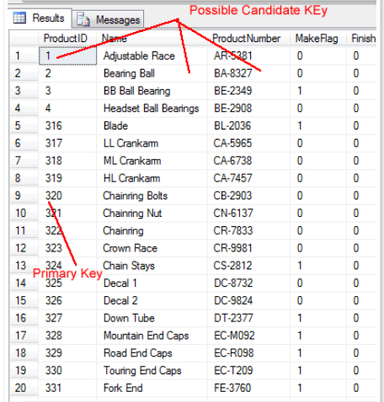

Slide 14
How to select Primary Key
select a key that does not contain NULL
Select a key that is unique and does not repeat
Make sure that Primary Key does not keep changing

Slide 15
Keys (continued)
Nulls:
No data entry
Not permitted in primary key
Should be avoided in other attributes
Can represent
An unknown attribute value
A known, but missing, attribute value
A “not applicable” condition
Can create problems when functions such as COUNT, AVERAGE, and SUM are used
Can create logical problems when relational tables are linked

Slide 16
Keys (continued)
Controlled redundancy:
Makes the relational database work
Tables within the database share common attributes that enable the tables to be linked together
Multiple occurrences of values in a table are not redundant when they are required to make the relationship work
Redundancy exists only when there is unnecessary duplication of attribute values

Slide 17
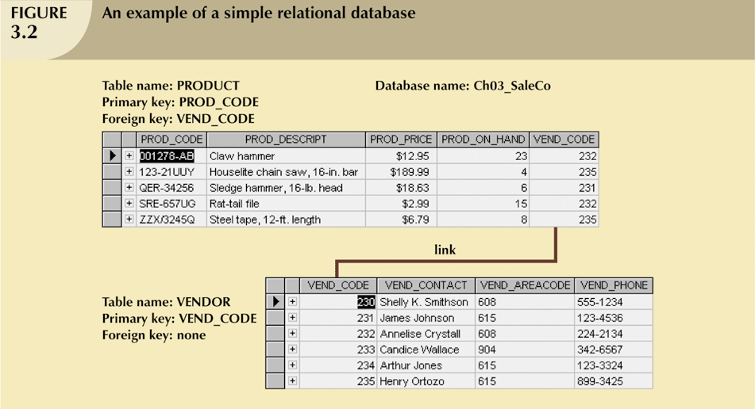
Keys (continued)

Slide 18
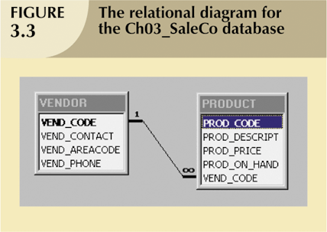
Keys (continued)

Slide 19
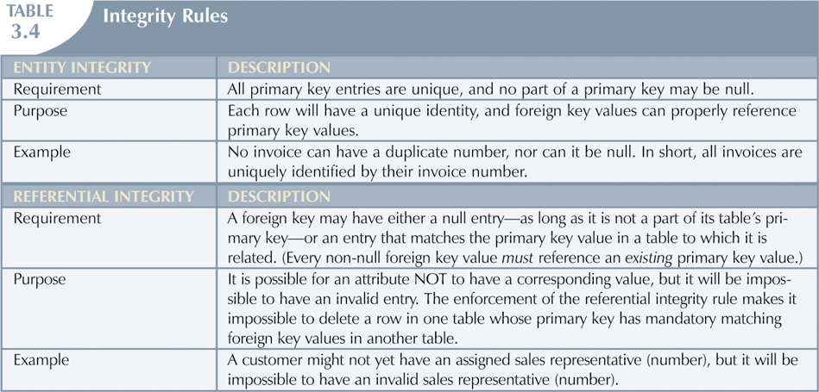
Integrity Rules

Slide 20
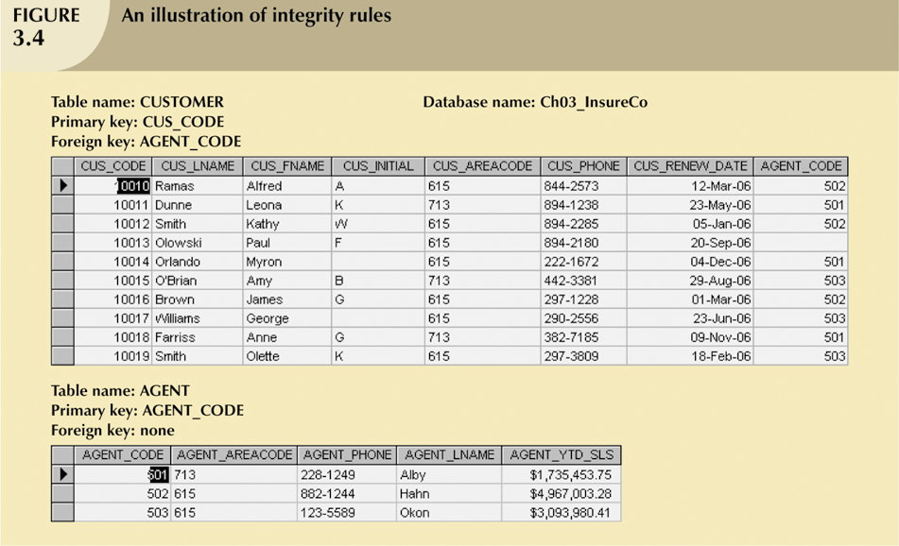
Integrity Rules (continued)

Slide 21
The Data Dictionary and System Catalog
Data dictionary
Provides detailed accounting of all tables found within the user/designer-created database
Contains (at least) all the attribute names and characteristics for each table in the system
Contains metadata—data about data
Sometimes described as “the database designer’s database” because it records the design decisions about tables and their structures

Slide 22
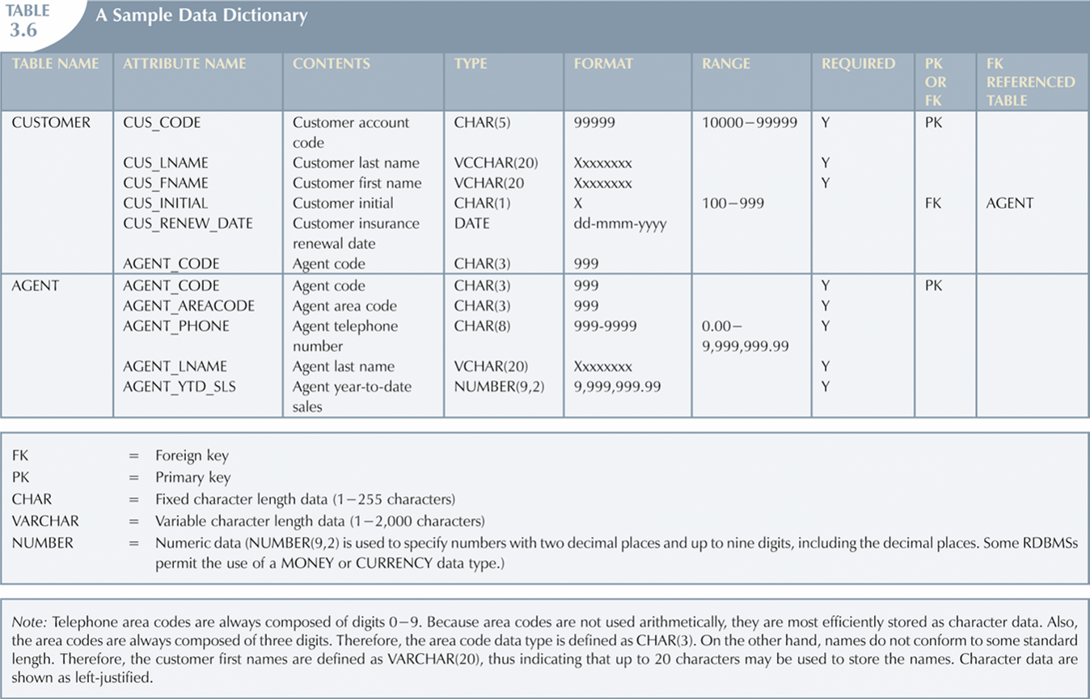
A Sample Data Dictionary

Slide 23
Quick Review Question
What is a candidate key?
What is a primary key?
What is a foreign key?
What is entity integrity?
What is referential integrity?
What is data dictionary?

Slide 24
Summary of Main Teaching Points
Tables are basic building blocks of a relational database
Keys are central to the use of relational tables
Keys define functional dependencies
Candidate key
Primary key
Secondary key
Foreign key

Slide 25
Question and Answer Session
Q & A

Slide 26
What we will cover next
The types of relationship within the relational model

